Slide 1
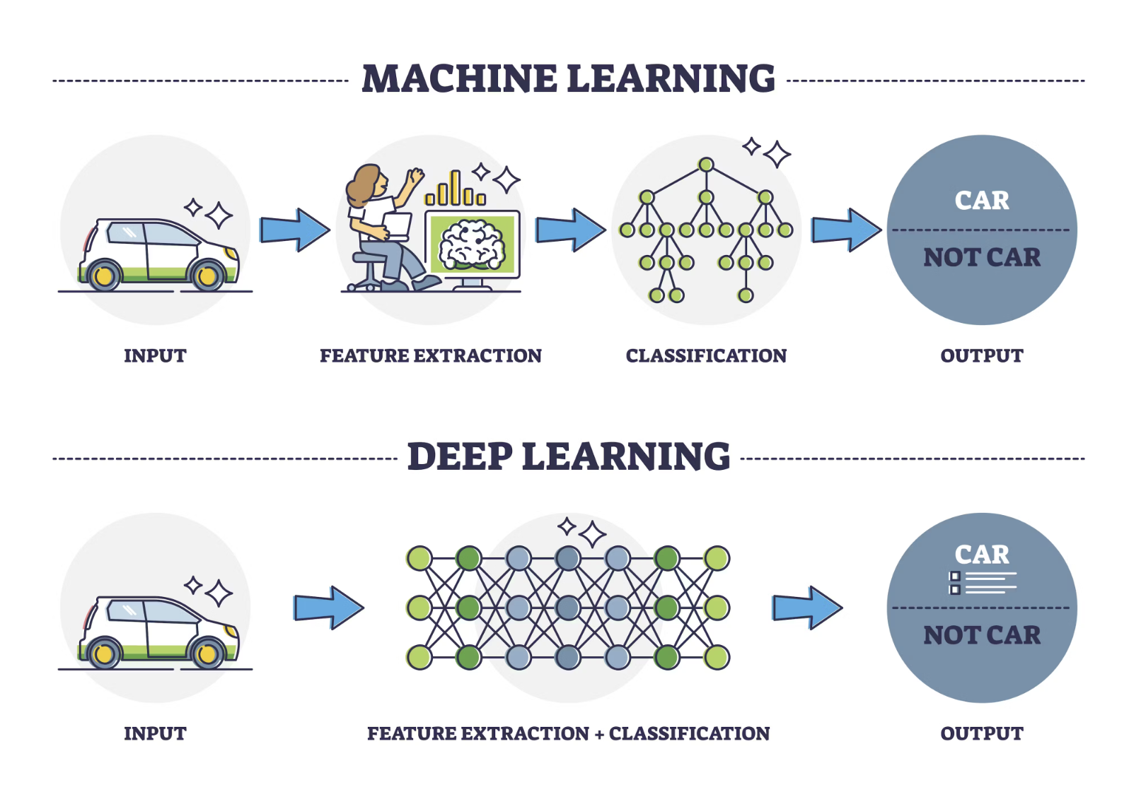
Deep Learning

Slide 2
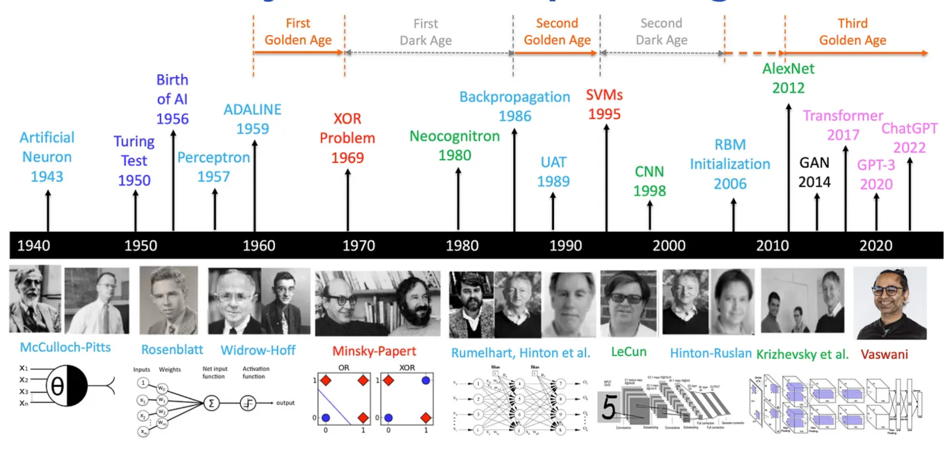
History of DL

Slide 3
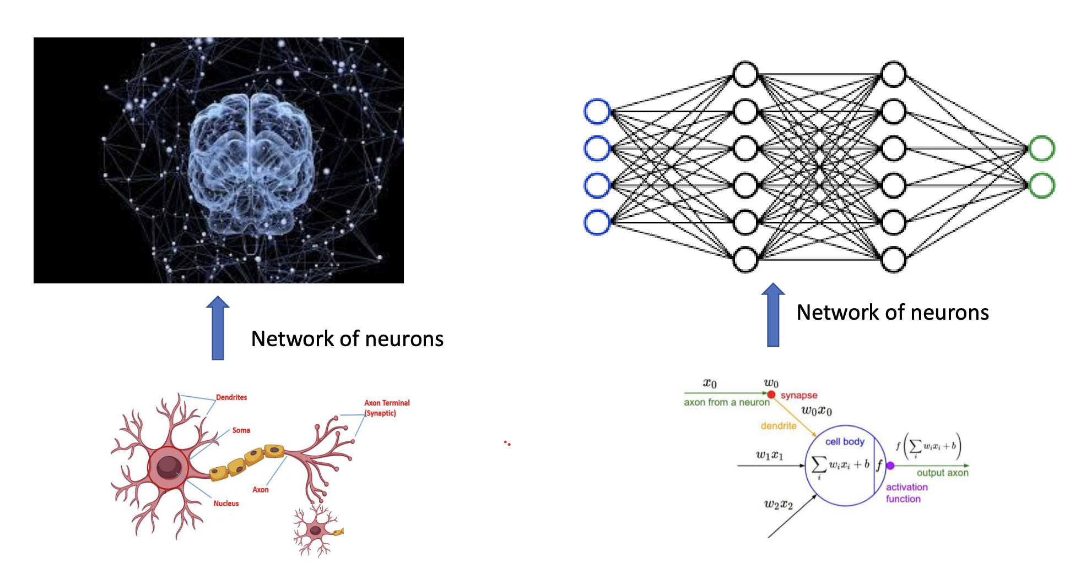

Slide 4
Basic Terminology: Neural network playground
Neural Network (NN): A neural network is a series of algorithms that mimic the way the human brain operates to recognize relationships in data. It’s composed of layers of interconnected nodes or "neurons."
Neuron (Node): A neuron is a basic processing unit in a neural network. It receives input, applies a mathematical operation (typically a weighted sum), and passes an output to the next layer of neurons.
Layers:
Input Layer: The layer that receives the initial data for processing.
Hidden Layers: Layers between the input and output layers that perform computations, transforming the data to allow for complex pattern recognition.
Output Layer: The final layer that provides the prediction or classification.
Weights: The parameters within the network that adjust during training to minimize error. They determine the influence of one neuron’s output on the next neuron.
Bias: An additional parameter that adjusts the output along with weights, helping to shift the activation function and improve model accuracy.

Slide 5
Activation Function
An activation function is a mathematical function applied to each neuron’s output to introduce non-linearity. Common activation functions include:
  ReLU (Rectified Linear Unit): Sets all negative values to zero.
  Sigmoid: Maps values between 0 and 1, useful for binary classification.
  Tanh: Maps values between -1 and 1, helping to normalize input.
Forward Propagation
The process of passing input data through the network (from input to output layer) to make a prediction.
Loss Function
A function that measures how far off the network’s predictions are from the actual values. The network learns by trying to minimize this loss. Common loss functions include:
  Mean Squared Error (MSE): For regression problems.
  Cross-Entropy Loss: For classification problems.

Slide 6
Backpropagation
The process of adjusting weights by moving backward through the network, using the loss value to correct errors. It helps in minimizing the loss function
Take notes from me
Gradient Descent
An optimization algorithm used to minimize the loss function by iteratively adjusting the weights in the direction that reduces error. Variants include Stochastic Gradient Descent (SGD) and Adam Optimizer.
Epoch
One complete pass through the entire training dataset. Typically, a neural network requires multiple epochs to optimize its parameters fully
Batch Size
The number of samples processed before updating the model’s internal parameters. Using batches helps in memory management and can speed up training through mini-batches.

Slide 7
Learning Rate
A hyperparameter that determines the step size at each iteration while moving toward a minimum of the loss function. Choosing an appropriate learning rate is critical; too high may lead to divergence, and too low may slow down training
Regularization
Techniques used to reduce overfitting, such as L1/L2 regularization, dropout (randomly setting neurons to zero during training), and batch normalization.

Slide 8

Famous DL Frameworks
https://www.tensorflow.org/api_docs/python/tf/all_symbols
TensorFlow: Developed by Google
Official Link : https://www.tensorflow.org/

Slide 9
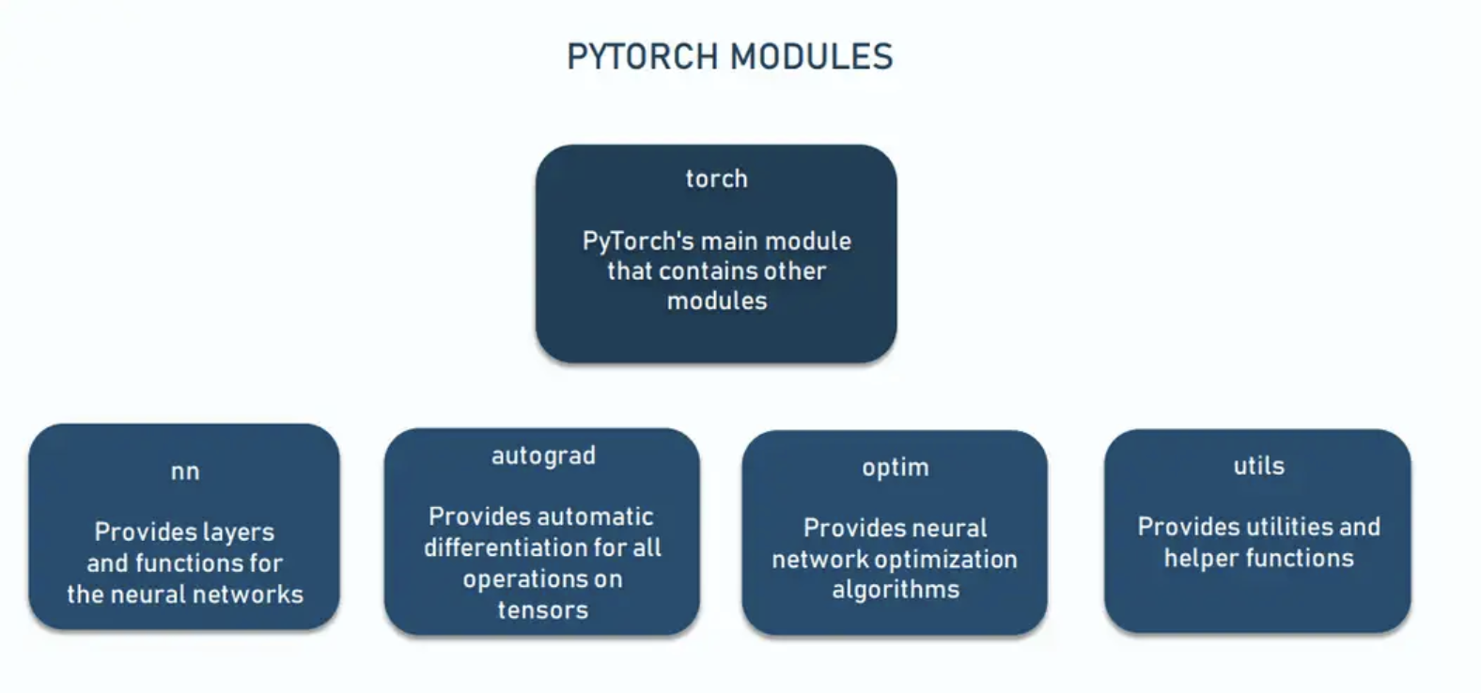
Pytorch : Developed by Facebook's AI Research lab
Official link: https://pytorch.org/tutorials/beginner/basics/intro.html

Slide 10
